Slide 1
Gesture Based Tool for Sterile Browsing of Radiology Images
Team ID:PNT2022TMID29553

Slide 2
Team Members
AKASH M -510419205002
JEEVANESH V -510419205011
SRIRAM E -510419205030
VETRISELVAN T -510419205036

Slide 3
ABSTRACT
This project method to improve the navigation and manipulation of radiological images through a sterile hand gesture recognition interface based on attentional contextual cues. Computer vision algorithms were developed to extract intention and attention cues from the surgeon's behavior and combine them with sensory data from a commodity depth camera. The developed interface was tested in a usability experiment to assess the effectiveness of the new interface. An image navigation and manipulation task was performed, and the gesture recognition accuracy, false positives and task completion times were computed to evaluate system performance. Experimental results show that gesture interaction and surgeon behavior analysis can be used to accurately navigate, manipulate and access MRI images, and therefore this modality could replace the use of keyboard and mice-based interfaces.

Slide 4
PROBLEM STATEMENT
The use of doctor-computer interaction devices in the operation room (OR) requires new modalities that support medical imaging manipulation while allowing doctors' hands to remain sterile, supporting their focus of attention, and providing fast response times. This paper presents “Gestix,” a vision-based hand gesture capture and recognition system that interprets in real-time the user's gestures for navigation and manipulation of images in an electronic medical record (EMR) database. Navigation and other gestures are translated to commands based on their temporal trajectories, through video capture. “Gestix” was tested during a brain biopsy procedure. In the in vivo experiment, this interface prevented the surgeon's focus shift and change of location while achieving a rapid intuitive reaction and easy interaction. Data from two usability tests provide insights and implications regarding human-computer interaction based on nonverbal conversational modalities.

Slide 5
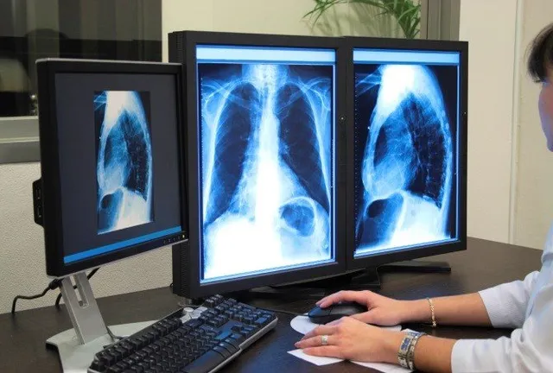
SOLUTION
Thus we prepared our project which us insisted by ibm here we can browse the image via gestures without touching the computer.

Slide 6
PROPOSED SOLUTION
Parameter | Description
Problem Statement | At present Doctors are interacting with system via hands which will be infection via germs during the operation , thus we are going to the contactless navigation of radiology images for treatment using ML model to identify the gestures.
Idea / Solution description | To avoid the contact gesture based communication is implemented using CNN and Cameras which detects the gestures ,Which will be absolutely sterile.
Novelty / Uniqueness | We are going to use the CNN for recognizing the gestures. We are going to train the model with hand Gestures. Even we may use AI for Recognizing the clear image even with Bad background. We are providing the various features in Image viewing with Interaction module.

Slide 7
PROPOSED SOLUTION
Social Impact / Customer Satisfaction | Our model will help the doctors in OT via contactless interaction which gives Germ free communication and it will reduce the sterilizing process in operation .Which ensures the infections to the patients.
Business Model (Revenue Model) | We will provide our model for subscription based Manner we could generate revenue though this method.
Scalability of the Solution | In future we can expand our project via more additional gestures for browsing. Even we may implement the multiple inputs a time.

Slide 8
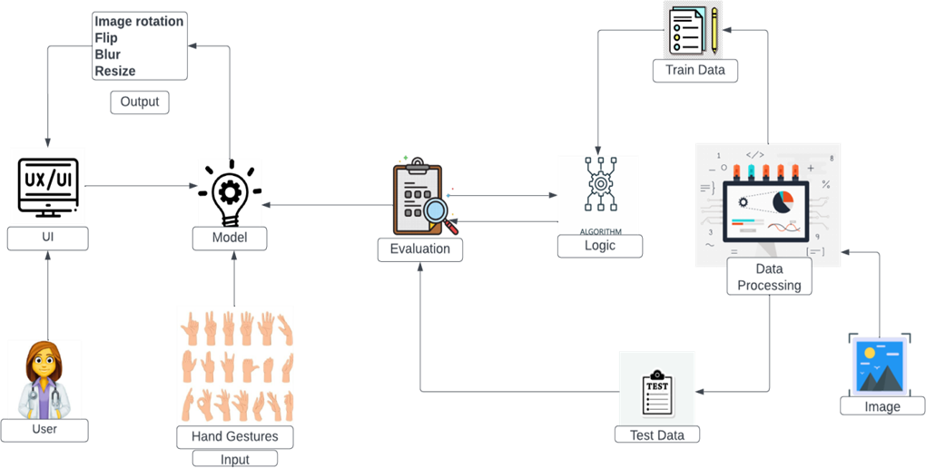
TECHNICAL ARCHITECTURE

Slide 9
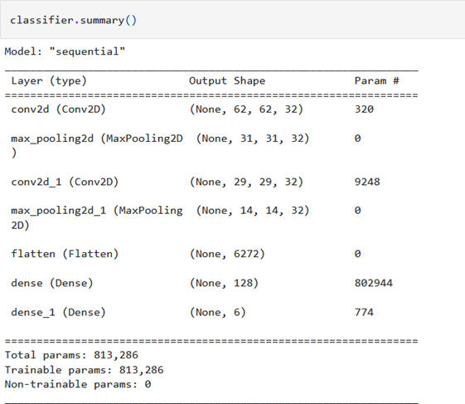
PERFORMANCE MATRICS
Model Summary:

Slide 10
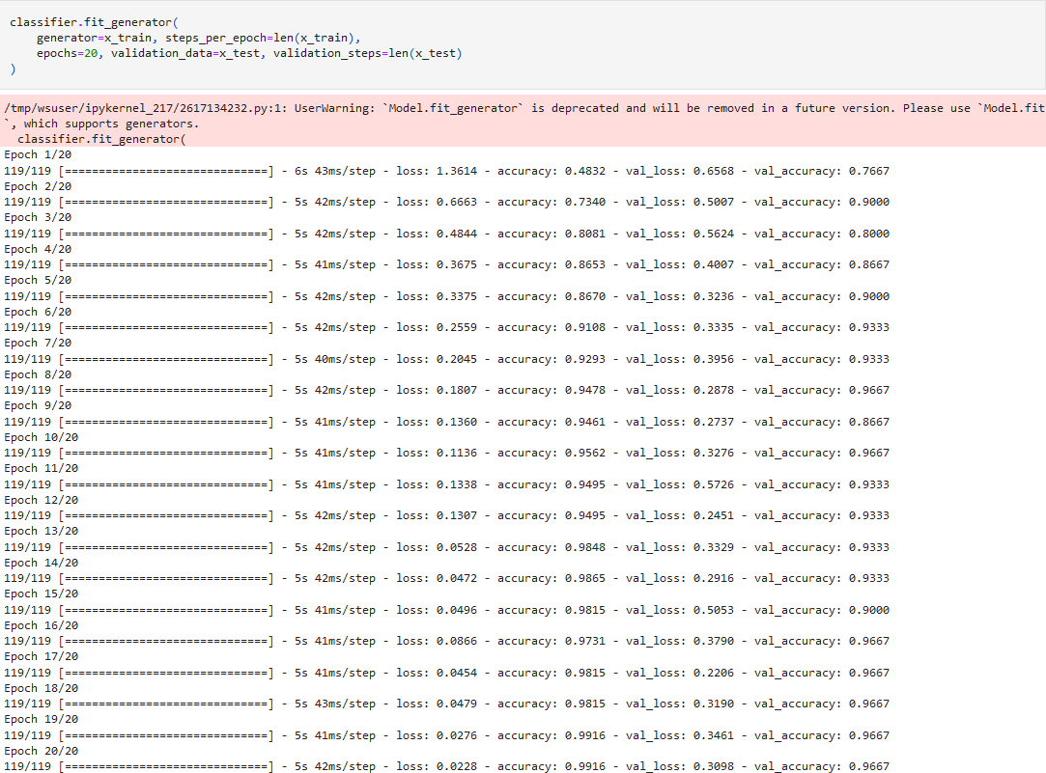
PERFORMANCE MATRICS
Accuracy: Training Accuracy - 99.16% Validation Accuracy – 96.67%

Slide 11
FUTURE SCOPE
The tool can be made quicker by increasing the recognition speed. More number of gestures can be added thereby increasing this tool’s functionality and usability for different purposes. Tracking of both hands can be added to increase the set of commands. Voice commands can also be added to further increase the functionality.

Slide 12
DEMO OF THE PROJECT
https://youtu.be/dvHLtEuLeOk

Slide 13


